Slide 1
User Manual
Triple Axis Reduction Software with Polarized He-3 Correction

Slide 2
Acquire Software
Go to www.ncnr.nist.gov
Go to Triple Axis website
Download latest version of PolAppSetup.exe to c:/ drive
Executable should install on c:/ drive into Polcorrecter folder
Double click PolApp.exe to run software
Panel will appear

Slide 3
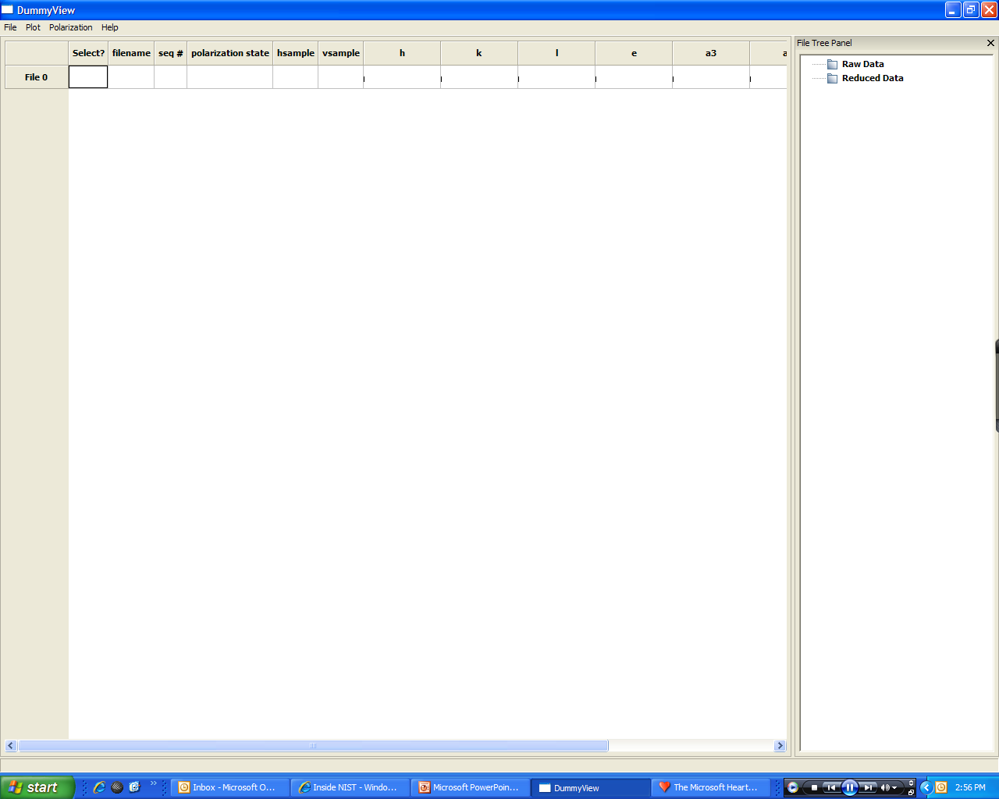
Software Panel

Slide 4
Load Data
Choose Polarization menu located at top left
Choose Load Data and select data to be reduced
Files can be sorted by double clicking on a column header
Sample Data files are available for instruction

Slide 5
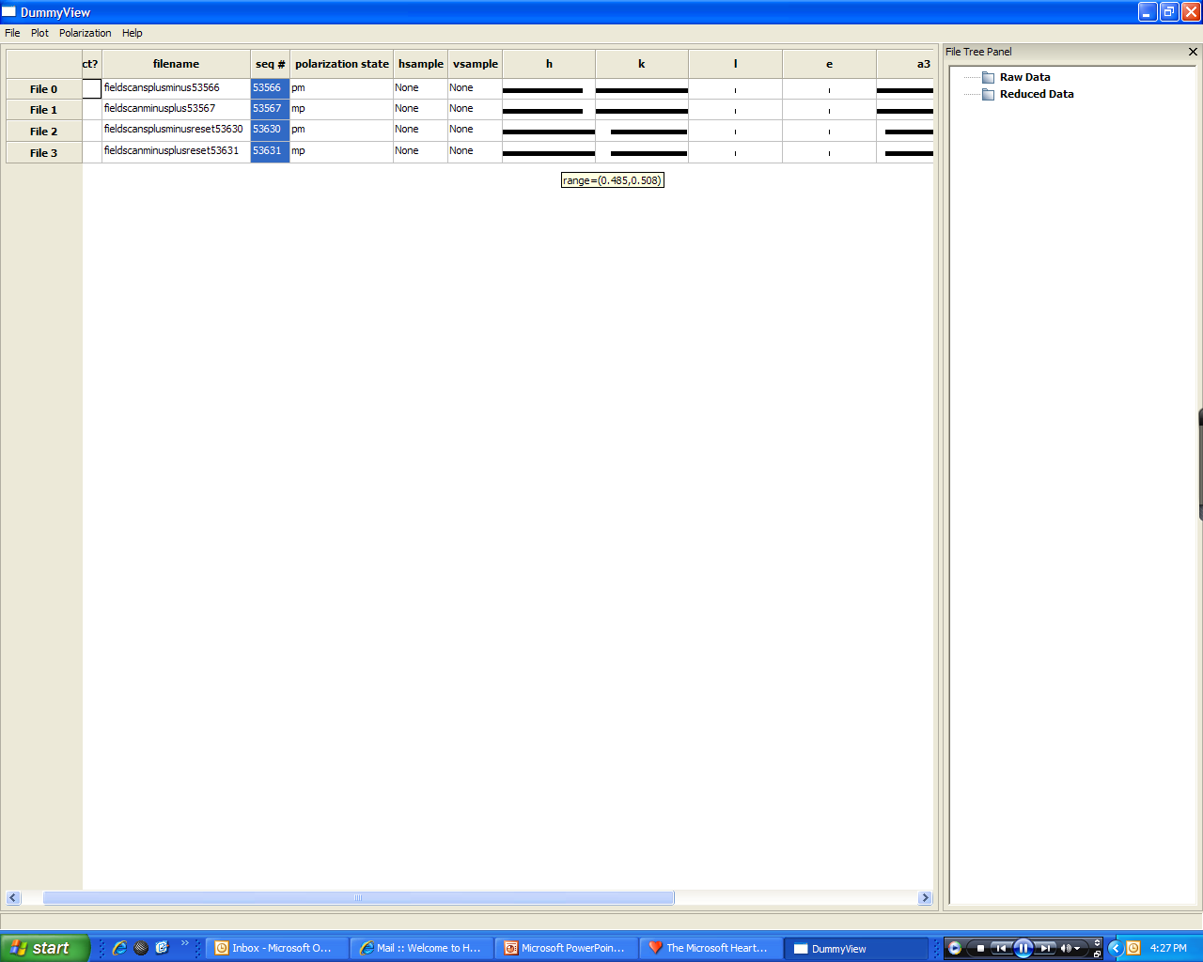
Data Loaded
Placing the cursor over a column value shows the parameter range over which the data was taken
Ex. Panel above shows the range in ‘h’ for file 3 when the cursor is placed over the black bar

Slide 6
Column Labels
File # | Name and number given to loaded file
Select | Shows which files are selected for reduction
Filename | Name of file loaded
Polarization state | m = minus, p = plus (ex. mp means minus (flipper off), plus (flipper on) scattering)
hsample | Horizontal sample applied field
Vsample | Vertical sample applied field
h, k, l | Orientation of crystal plane relative to detector
e | Energy transfer (note: no values in the column represents elastic scattering)
a3
a4
Temp | Sample temperature of measurement
Magfield | Applied magnetic field during measurement
More parameters can be seen at one time by dragging the bar between the data and file tree panels

Slide 7
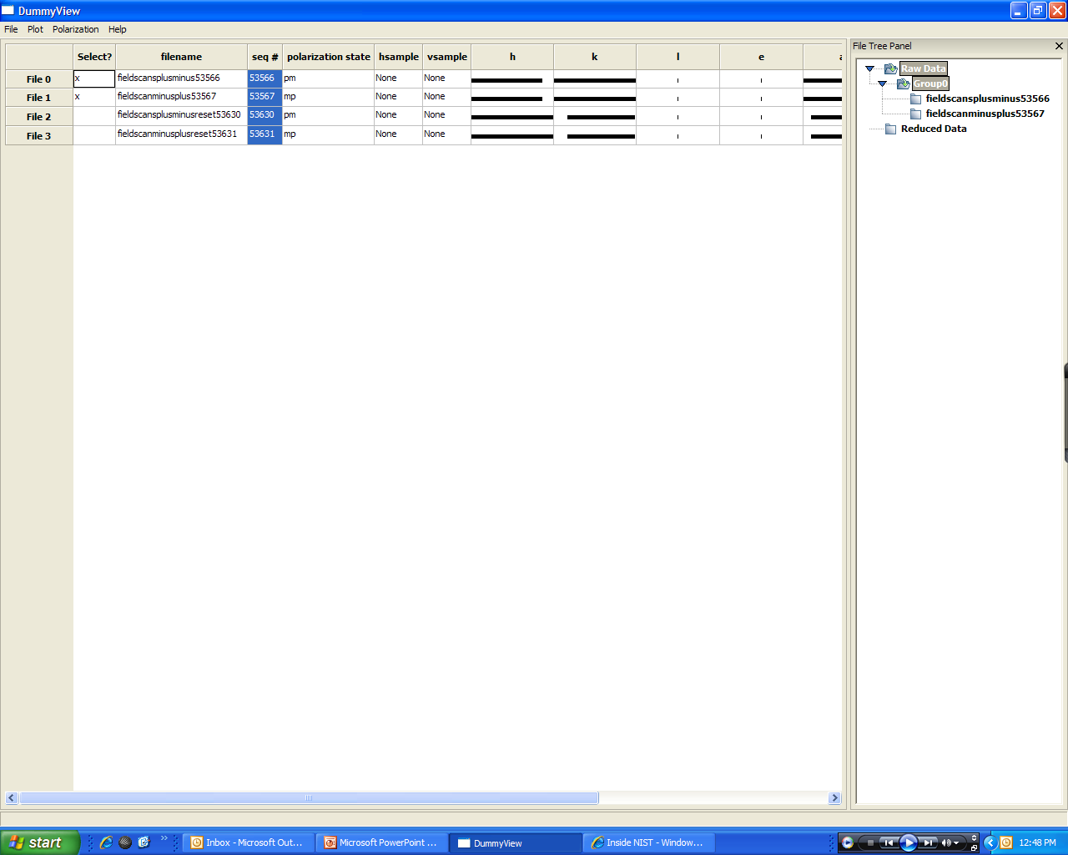
Select Data for Reduction
Click the box under Select next to the data you want to reduce
Right click anywhere in that panel and select ‘Send group for reduction’
Data will appear under the Raw Data tab in the File Tree Panel to the right

Slide 8
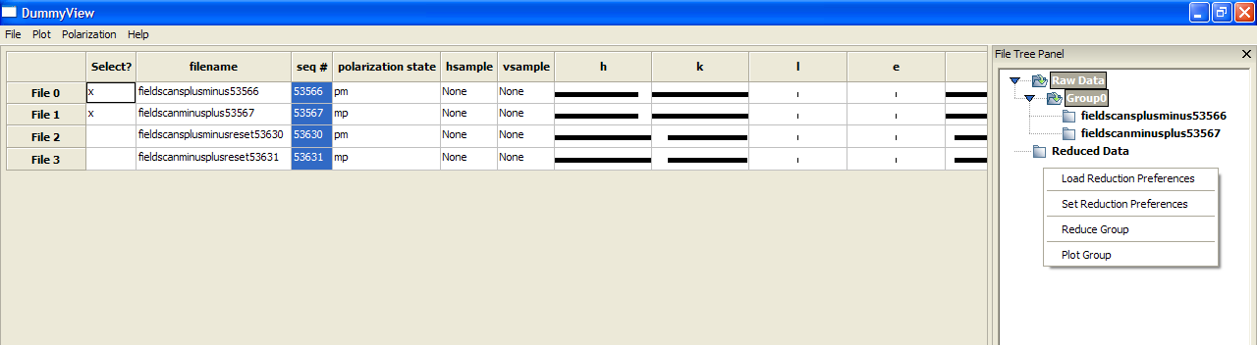
Data Reduction → Options
Right click in File Tree Panel to see reduction options
Choose Load Reduction Preferences to use previously saved settings
Choose Set Reduction Preferences to set reduction parameters

Slide 9
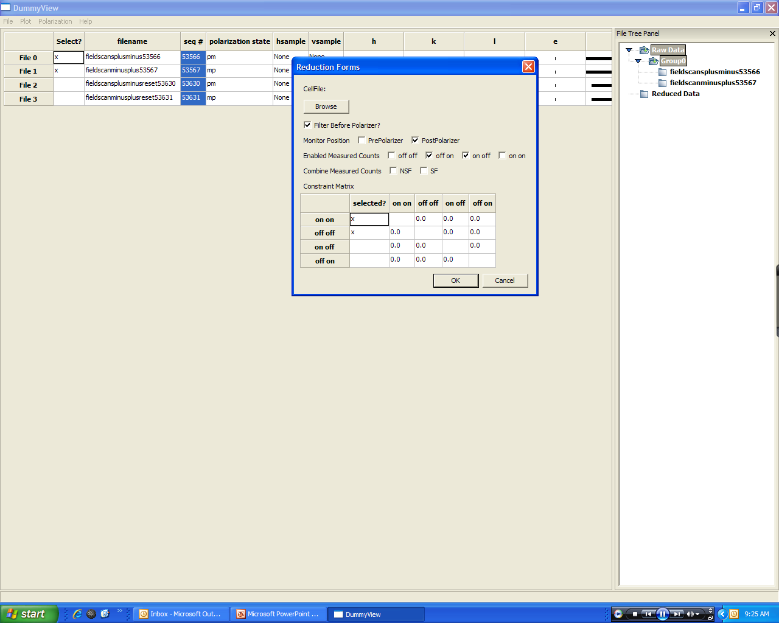
Data Reduction → Set Preferences
In Reduction Forms panel
  Use Browse tab to load He-3 polarization correction information for cells (ex. cells.txt)
  Select parameters that apply to experiment

Slide 10
Data Reduction → Reduction Forms
Filter Before Polarizer | Check box if a filter before the polarizer
Monitor Position | Check appropriate box
Enable Measured Counts | Flipper combination
Combine Measured Counts | Will combine data for both SF cross sections or NSF cross sections
Constraint Matrix | User inputs constraints for each cross section

Slide 11
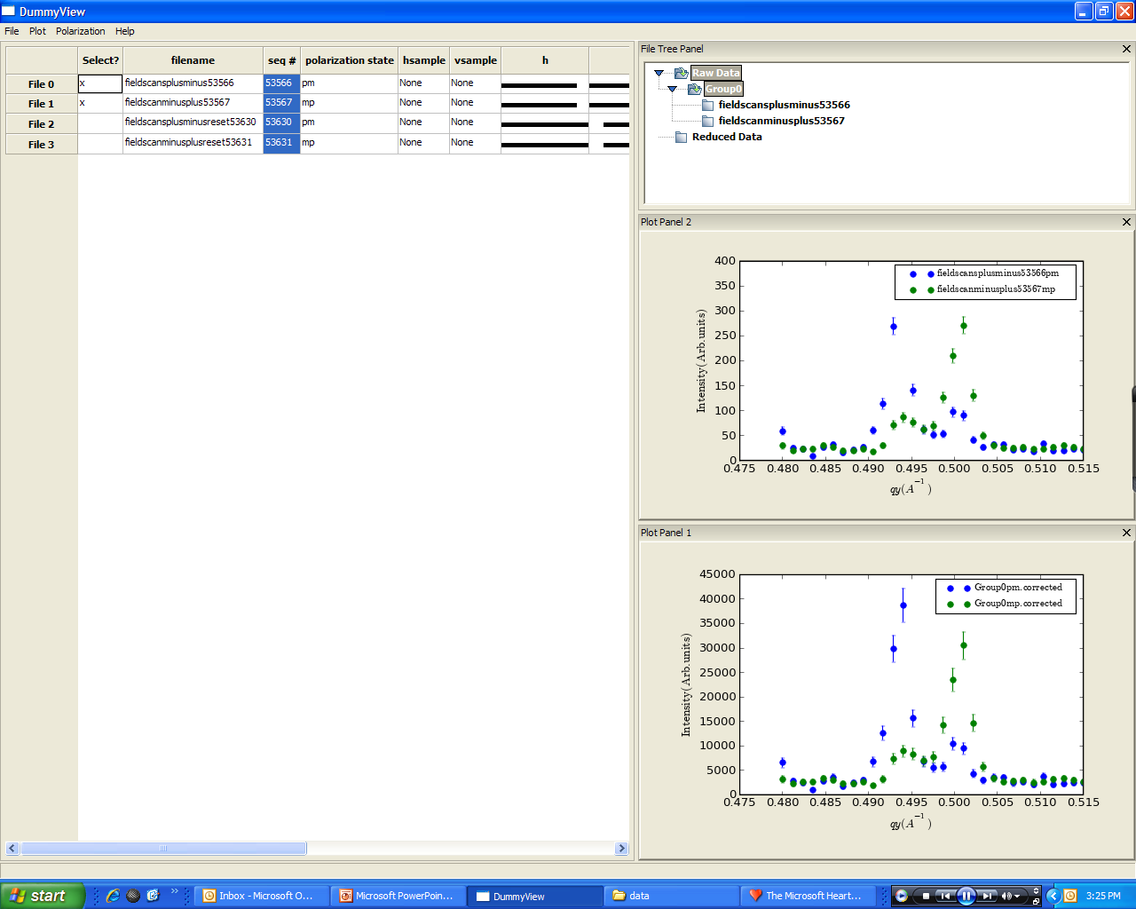
Reduce Group
After setting reduction parameters → right click and select Reduce Group
Plots will appear of raw data and corrected data
Individual panels can be dragged outside the main panel for enlargement

Slide 12
Save Info
Right click on individual plot panels to save a text file of the plot and/or plot image
Note that after using the “reduce group” option a “.out” file will be made with the reduced data in an “ICE” format. The corrected data will be in the detector_corrected and detector_errs_corrected columns

